Slide 1
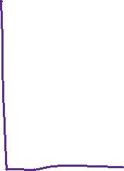
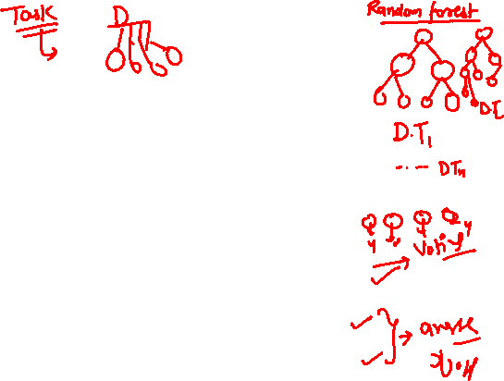
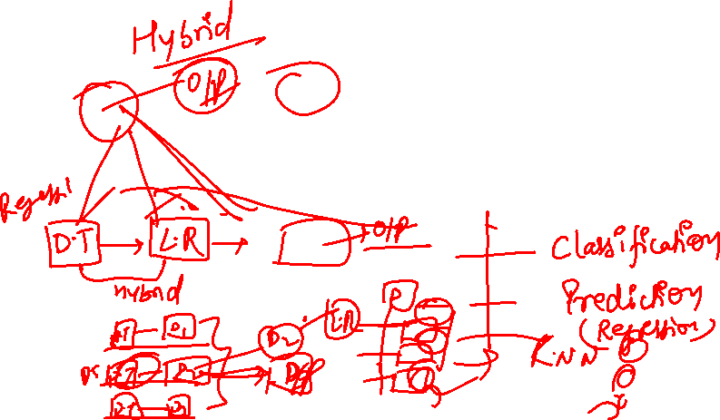
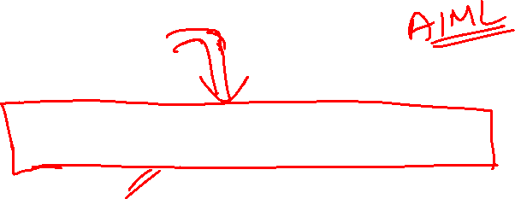
Ensemble Learning

Slide 2
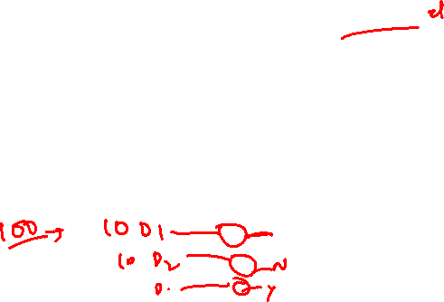
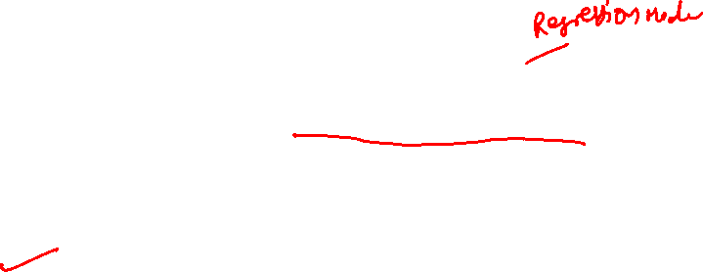
Ensemble Learning
So far, learning algorithms that learn single model.
Ensemble Learning: Technique to create multiple classification models and then combine them to produce improved results.
Example 1: generate 100 different decision trees from the same or different training set and have them vote on the best classification for a new example.

Slide 3
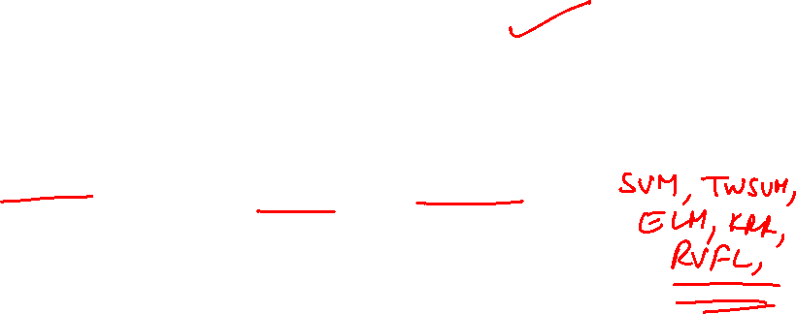
Ensemble Learning
Applied to regression as well as classification.
For regression creates multiple regression models such as linear, polynomial, etc.
For classification creates multiple classification models such as logistic regression, decision trees, k-nn classifier, etc.

Slide 4
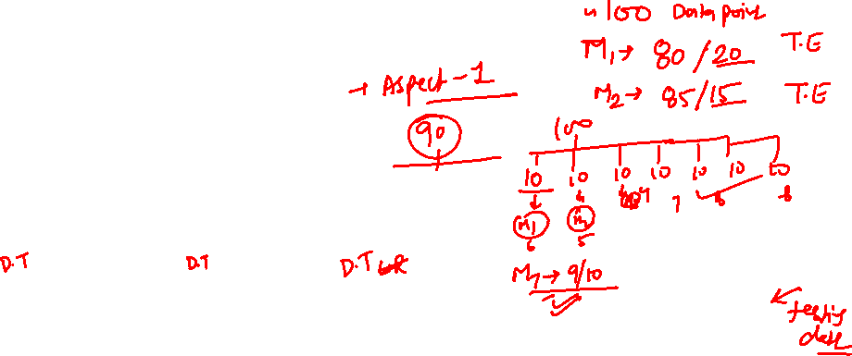
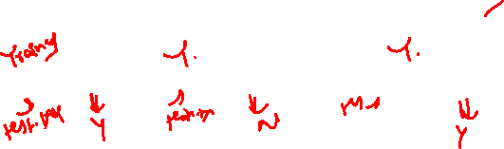
Ensemble Learning
Training data
Data 1
Data 2
Data n
Perform Predictions
Learner 1
Learner 2
Learner n
Final Model
Model 1
Model 2
Model n
Model Combiner

Slide 5
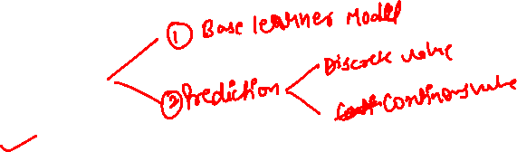
Ensemble Learning
A two-step process:
Generate multiple machine learning models; called as Base models.
Perform predictions on the basis of these base models.

Slide 6
Ensemble Learning
“No Free Lunch” theorem
No single algorithm wins all the time.
When combining multiple independent and diverse decisions each of which is at least more accurate than random guessing, random errors cancel each other out, correct decisions are reinforced.

Slide 7
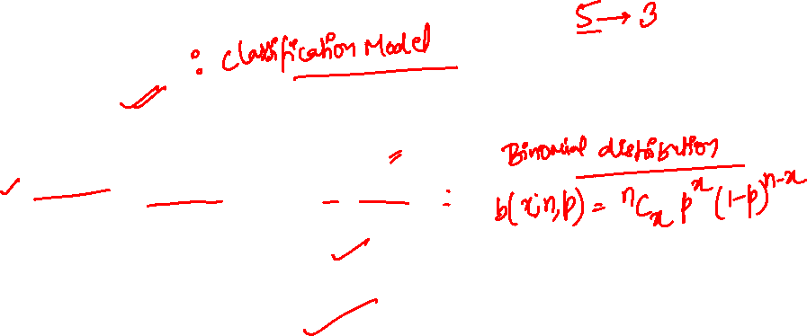
Intuitions
“Majority Vote”- Suppose we have 5 independent classifiers:
If accuracy is 70% for each
    ⁵C₅(0.7⁵)+⁵C₄(0.7⁴)(0.3)+ ⁵C₃ (0.7³)(0.3²)
    (0.7⁵)+5(0.7⁴)(0.3)+ 10 (0.7³)(0.3²)
    83.7% majority vote accuracy
    101 such classifiers
    99.9% majority vote accuracy
Notes:
Note: Binomial Distribution: The probability of observing x heads in a sample of n independent coin tosses,
where in each toss the probability of heads is p, is

Slide 8
Ensemble Learning Techniques

Slide 9
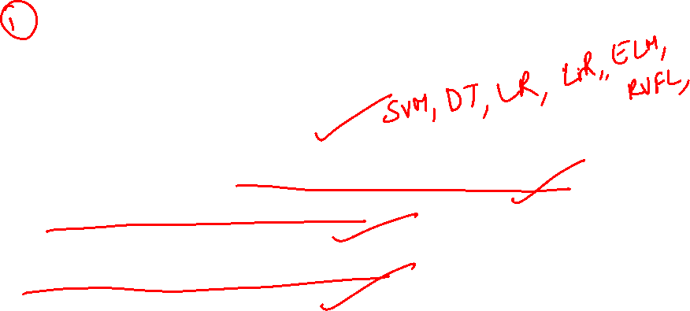
Generating Base Learners
Different learning algorithms
Algorithms with different choice of parameters
Dataset with different features
Dataset with different subsets

Slide 10

Base Learners
Base Learners
Homogeneous Base Learners
Heterogeneous Base Learners

Slide 11
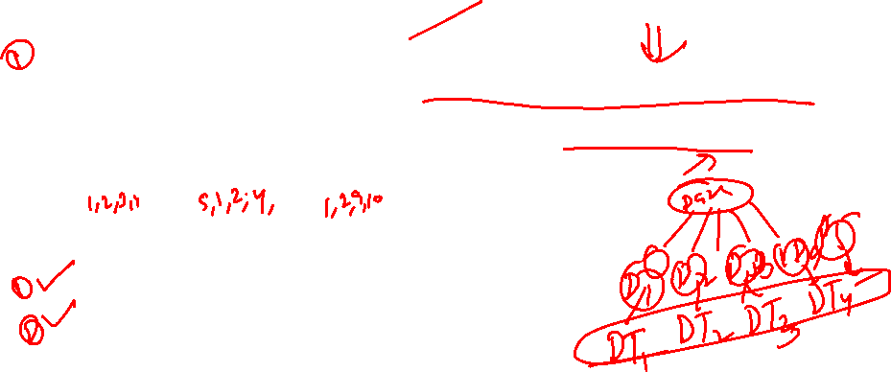
Homogeneous Learners
Generating Base Learners: Use single arbitrary algorithm but manipulate training data to make it learn multiple models.
Data1 = Data 2 = ……. = Data n
Different methods for changing data.
Bagging
Boosting

Slide 12
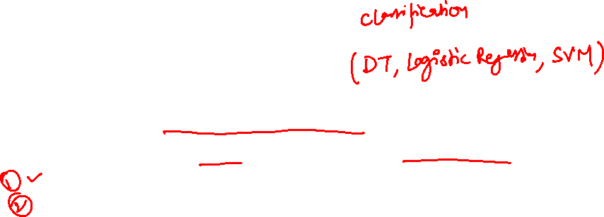
Heterogeneous Learners
Voting: train diverse base learners on a dataset to construct the models, then uses voting to predict the final output.
Hard Voting: prediction by simple majority vote.
Soft Voting: can only be done when all learners can predict probabilities for the output. It averages out the probabilities calculated by different learners.

Slide 13

Heterogeneous Learners
Stacking: combines decision of different learners for regression or classification.
Different learners learn in parallel
Use predictions as features to train a new model
Use new model for the final prediction

Slide 14
Bagging

Slide 15
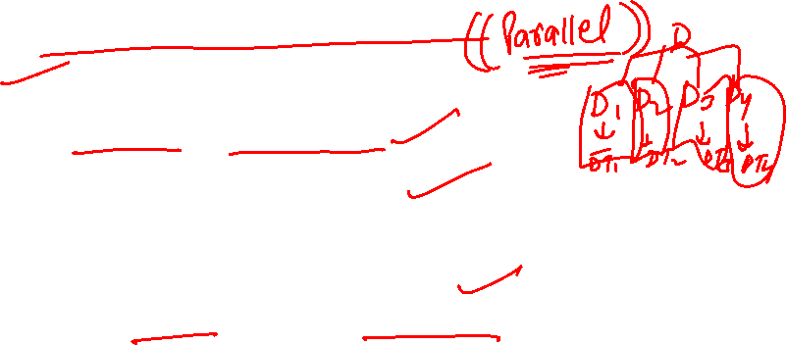
Bagging
Stands for Bootstrap aggregation
Consider homogeneous weak learners
Learns them independently from each other in parallel
Use an averaged model as the final model
Used for both regression and classification

Slide 16
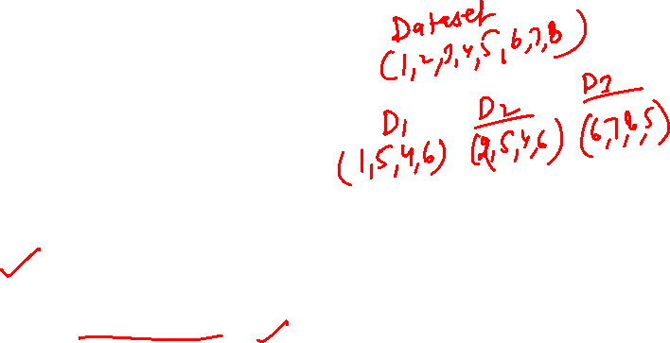

Bagging
Consists of two parts:
Boostrapping
Aggregation
1. Bootstrapping is a sampling method. Samples are chosen randomly out of a set with replacement.
2. Aggregation is combining the model predictions to obtain the final predictions.

Slide 17
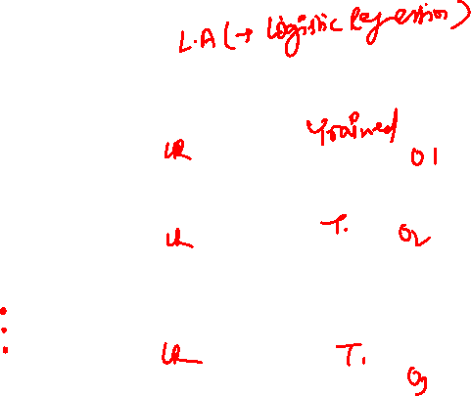
Bagging
Bootstrap Sample 1
Learning Algorithm
Model 1
Training Data
Bootstrap Sample 2
Learning Algorithm
Combined Predictions
Model 2
Final Prediction
Bootstrap Sample 3
Learning Algorithm
Model 3

Slide 18
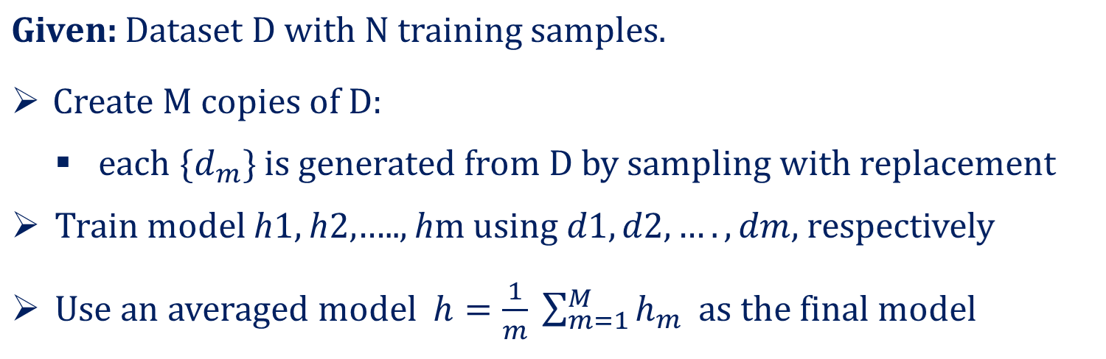
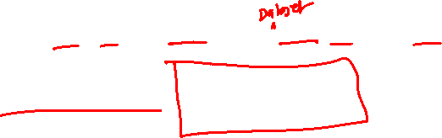
Bagging

Slide 19
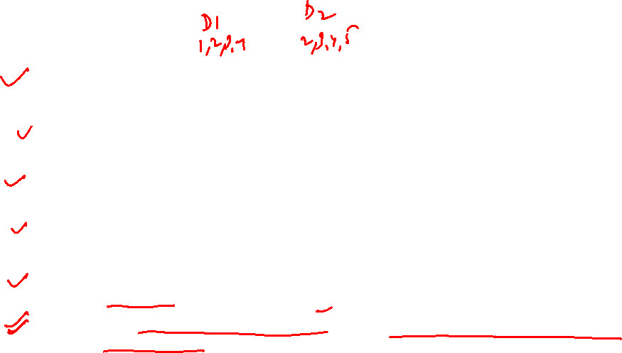
Bagging
Bagging generates additional data for training from the dataset. This is achieved by random sampling with replacement from the original dataset.
Sampling with replacement may repeat some observations in each new training data set.
Every element in Bagging is equally probable for appearing in a new dataset.
These multi datasets are used to train multiple models in parallel. The average of all the predictions from different ensemble models is calculated.
The majority vote gained from the voting mechanism is considered when classification is made.
Bagging decreases the variance and tunes the prediction to an expected outcome.

Slide 20
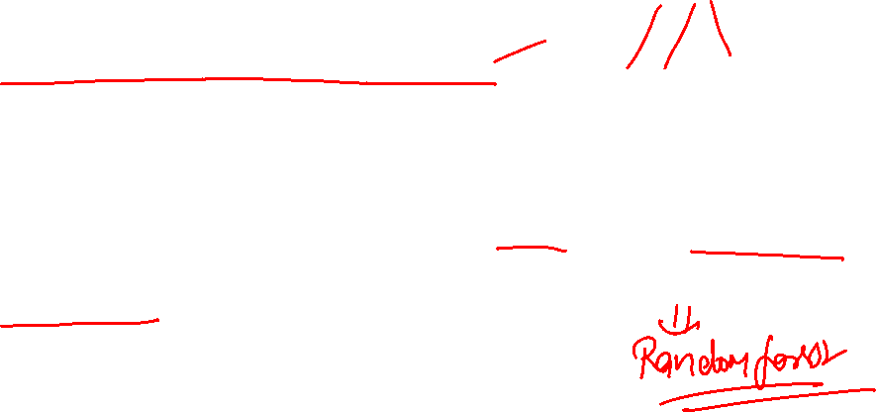
Bagging with decision tree
In Bagging with decision trees, individual trees are grown deep and trees are not pruned.
These individual decision trees have low bias and high variance
Bagging helps in reducing variance and hence controls overfitting

Slide 21

Bagging with decision tree
Example of Bagging:
The Random Forest model uses Bagging, where decision tree models with higher variance are present. It makes random feature selection to grow trees. Several random trees make a Random Forest.

Slide 22

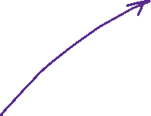









Boosting

Slide 23
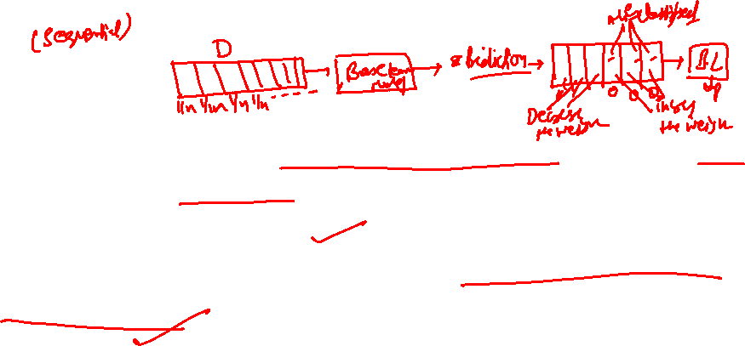
Boosting
Group of algorithms that utilize weighted averages to make weak leaners into strong learners.
Sequential training of learners.
Each model runs, then dictates what features the next model should focus on.

Slide 24
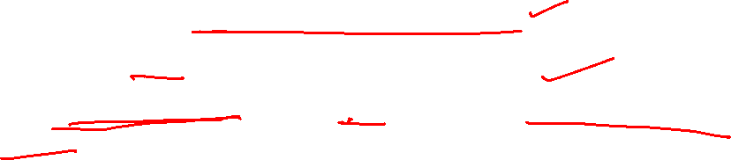
Basic Idea
First introduced by Freund and Schapire(1997), with their AdaBoost algorithm.
Initially assigns equal weights to each sample.
Compute the error of each model on training data.
Give higher importance to examples on which the model makes mistakes.

Slide 25
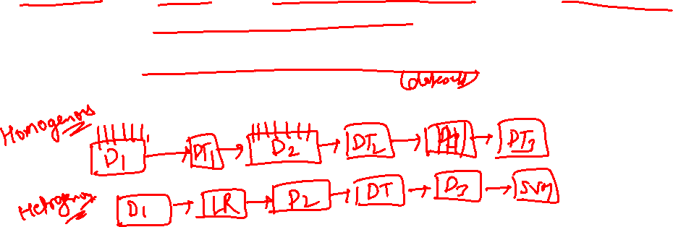
Basic Idea
Increase the weights of misclassified examples and decrease the weights of correctly classified examples.
Train the next model on the same examples but with modified weights.

Slide 26
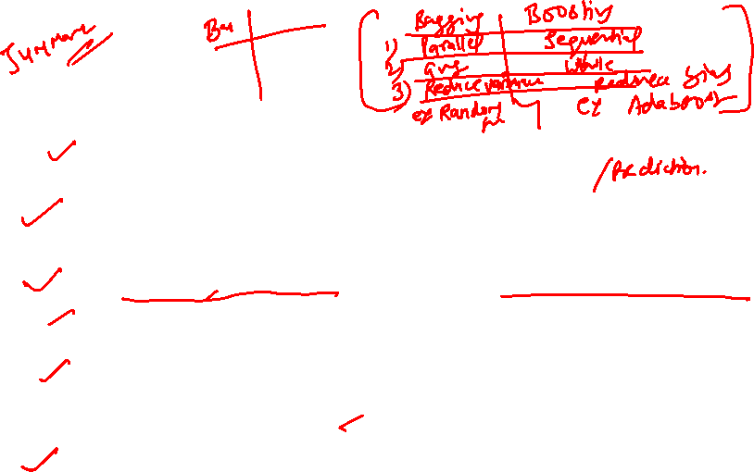
Boosting
Boosting is a sequential ensemble method that iteratively adjusts the weight of observation as per the last classification.
If an observation is incorrectly classified, it increases the weight of that observation. The term ‘Boosting’ in a layman language, refers to algorithms that convert a weak learner to a stronger one.
It decreases the bias error and builds strong predictive models.
Data points mispredicted in each iteration are spotted, and their weights are increased.
The Boosting algorithm allocates weights to each resulting model during training. A learner with good training data prediction results will be assigned a higher weight.
When evaluating a new learner, Boosting keeps track of learner’s errors.

Slide 27
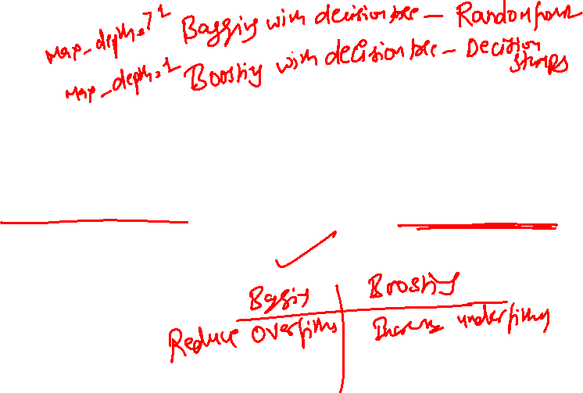
Boosting
Provides strong classification mechanism by combining weak learners resulting into strong classification model.
In case of decision tree learners, boosting makes decision stumps.
Decision stump is a tree with a single node.
Reduces the bias

Slide 28
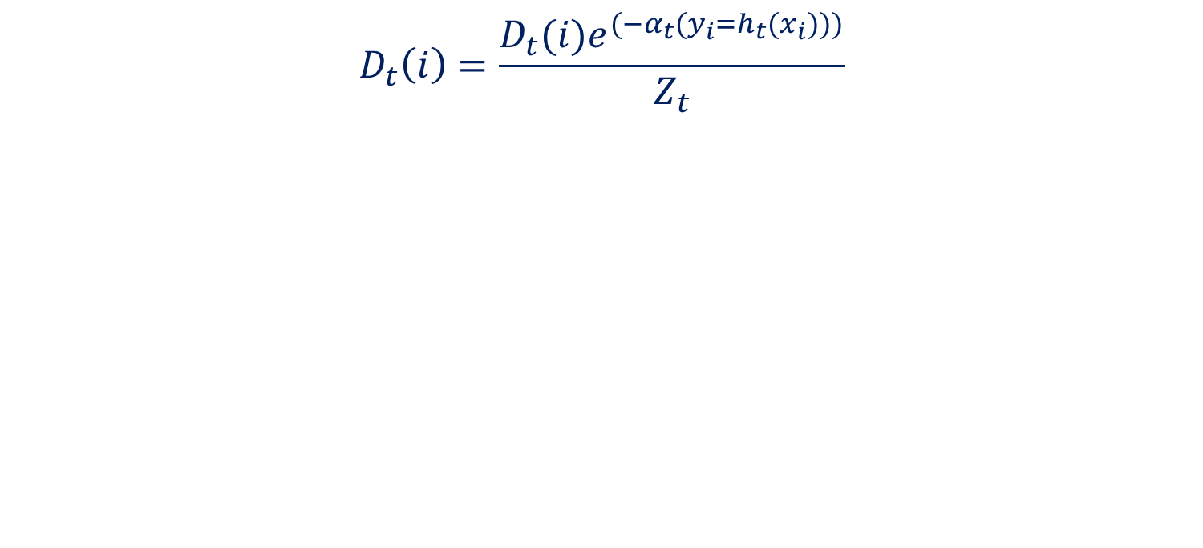
Boosting

Slide 29
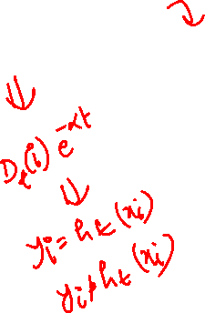
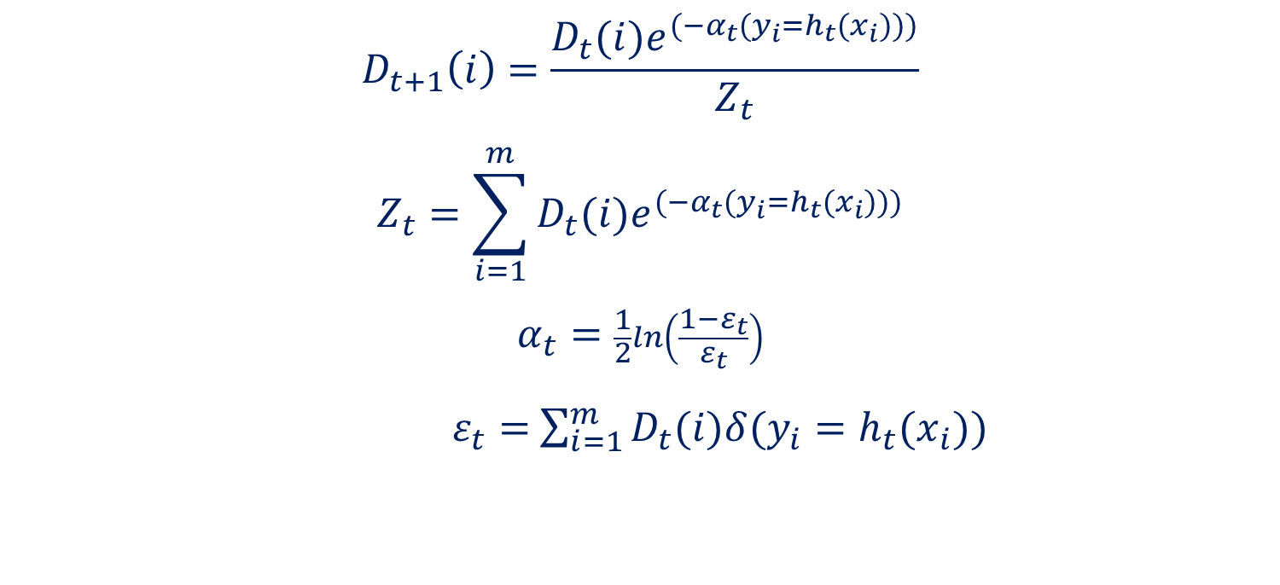
Boosting

Slide 30
Random Forest

Slide 31

Random Forest
An ensemble classifier consisting of bagging of many unpruned decision tree models.
It can be used for both: classification and regression.
Final Prediction is the mean of all predictions (regression) or class with maximum votes (classification).

Slide 32



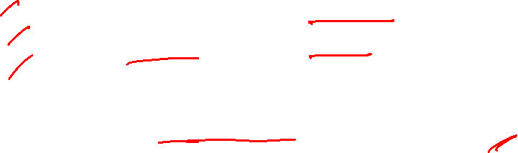
Random Forest Algorithm
Let N be the number of trees to build
for each N iterations:
Select a bootstrap sample from training set
Grow an unpruned tree on this bootstrap
At each internal node the tree generator determines which variable to split at a node and the variable to split
Output: final prediction as the average of the responses (regression) or majority class (classification)

Slide 33
Thank You

